Slide 1
EE 295
TechWriting-Engineering Ethics
Sep 12, 2019
Room E339
Tom Wrappe
EE Lecturer

Slide 2
Agenda
Direction/Feedback:
Science vs Engineering
Plagiarism and Teams
Out of Class Assignment #2: Blockchain
Midterm Paper
Topic Submission
Progressive steps to “5 Pager” midterm
Topic Discussions
Ch 3: Colonization and Contextualization
Impact of Technology
Writing Topics
Paragraph Construction
Passive Voice

Slide 3
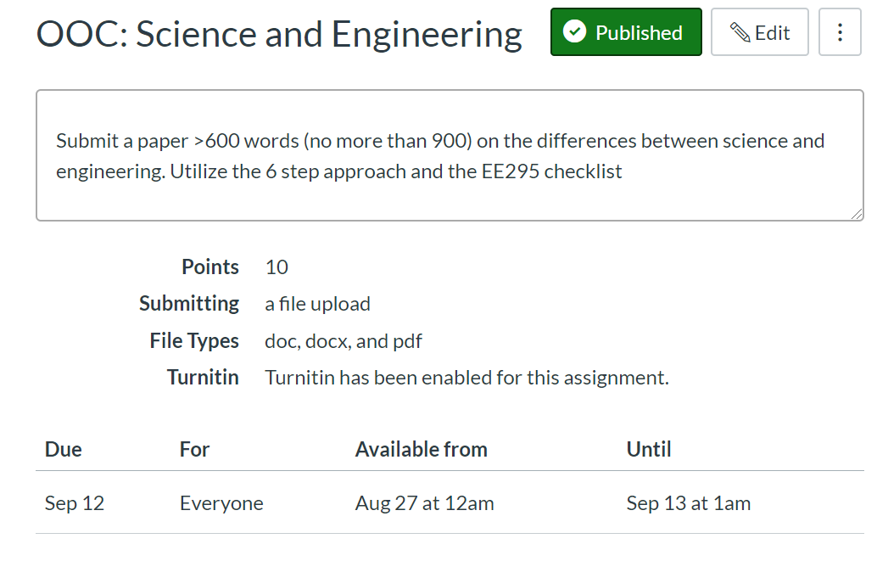

Slide 4
Out of class writing exercise #1: Differences between Engineering and Science (Recommended Content)
Criteria | Examples | Comments
Clear Conclusion | Science and Engineering share many of the same tools, but have many differences in their fundamental goals and motivations | -State early in the document -Summarize in different words at end of the document
Concisely Stated | One page, approx 600 words is sufficient | Don’t write “filler” that goes beyond the instructions and make the paper repetitive. Choose powerful macro examples to back up your assertions.
Good Flow | 4 or 5 Good paragraphs with solid structure (Example of solid structure) -Introductory Statement/Conclusion -How Science and Engineering Differ (with support) -How Science and Engineering Share common elements (with support) -Conclusion | -Each paragraph should have one unique topic sentence ‘---UNDERLINE FROM NOW ON. -Non topic sentences support the topic sentence +Body sentences +Conclusion sentence finishes the paragraph
Strongly Supported | -Provide actual concrete examples of where science and engineering differ -Goal of engineering is improvement, while science is seeking knowledge -Starting point of engineering is a problem, while science starts with a thesis | -Supporting elements for each assertion -Summarize the contrast between science and engineering and restate/reinforce the conclusion

Slide 5
Out of class writing exercise #1: Differences between Engineering and Science (Recommended Grammar)
Criteria | Examples | Comments
Grammar | Use the EE295 checklist as a point of reference
-No personal pronouns | I, me, it, they | All can be ambiguous . Use descriptive nouns, like “the bridge” or “the project” to make reference. No place for personal pronouns –stay to 3rd person. “It” is especially ambiguous. Only use when absolutely clear what “it” is…
-Small Paragraphs | Conclusion is a full paragraph, not two sentences | Have one topic sentence per paragraph. For a well constructed paper, you should be able to read only the topic sentences and see the flow of the paper.
-No passive statements | Avoid “was done” or “were deduced”…. | Say “Scientists develop theories…” or “engineers develop products”
-Articles | Use The, a, an, properly
-Complete Sentences | Always have a subject and an object | “whereas” is a sentence connector, not a verb
-Plagiarism | Need to run check to keep target of less than 15% | Turnitin provides feedback

Slide 6
Areas for Focus
Paragraph Construction
-Topic Sentences lacking in many papers
-Underline full topic sentence of every paragraph
-Supporting sentences “support” the topic
-Conclusion sentences finish the paragraph off
Overall Paper Construction
-Read the underlined topic sentences of the paper
-The flow should be obvious if well done
I, me, my, it: Avoid Personal Pronouns
Avoid Passive Voice
-Engineers developed the product, not The product was developed by the engineers..
5. Contractions have no place in formal writing nor do colloquialisms
-”Do not”, not “Don’t”; “Cannot”, not “Can’t”
-Not “On the other hand” , Use “ alternatively”

Slide 7
Science vs Engineering Issues from Previous Submissions
1. Personal pronouns (I, we, they)--Do a word search on I, we, they, you, me, it and highlight in every paper from now (summary at bottom)
2. Special case for "it"--ambiguous
3. Structure of paragraphs
4. Flow. Summary-->Body--> Conclusion
5. Summary is essential. Answer the question "how do science and engineering differ" in the first para
6. Wasting your first paragraph (or first sentence) on tangential stuff (Junk Thoughts): Direct and strong opening is best
7. Wasted words--"very",
8. Some people say....(wasted sentence)
9. Last paragraph, No need to say "in conclusion" or "to finish this up" -redundant and unneeded. First para does not need "First of all“ (wasted words)
10. Sweeping statements that cannot be backed up.
11. No Contractions in EE295
12. Famous quotes at the beginning of the paper....Not necessary. Put at the end if you want....
13. Inexact, informal phrases: "is all about..." "for sure",
15. Firstly, Secondly,....not needed often
16. informal words like "from Scratch" instead of "original“
17. Every paper has a Descriptive Title> Not "homework or midterm or final paper"

Slide 8
In Class Writing Assignment #1
Pete works for CISCO and is given his first major project from his Manager. The project is a team effort and one week before the project is due, Pete finds out that Valeria has chosen to “copy and paste” a majority of her “background and introduction”. Pete confronts Valeria and asks her to redo her paper without plagiarizing, but Valeria claims she is too busy . She assures Pete that their Manager will never discover the plagiarism, and that, if he does, that she will take complete blame for it.
Pete finds himself in an extremely uncomfortable position. He feels partly responsible for the plagiarism that he discovered; however, Valeria claims she will take all of the blame. Should Pete talk to the Manager about the situation?
What should Pete do in this situation?
a. Clear statement of Proposed Plan
b. Structured derivation of the chosen plan (options, selection criteria)

Slide 9
Plagiarism In Class Assignment
Write a 200-300 word paper to describe what Pete should do in this situation.
Use your 6 step process to prepare (do not just start writing, plan out your work)
Who is the audience?
Key thoughts on the issues
Structure your work before writing
Develop your structure (Intro, body with support, conclusion)
Remember to incorporate the appropriate grammar items
No personal pronouns—”I, we, it, they, etc”
Avoid passive voice
Well structured paragraphs with ONE topic sentence per..
Concise, simple statements with good flow (300 words = 1 page)
Write Name and ID number on top of sheet and turn in

Slide 10
Analysis
What are the key elements?
Team effort well underway with only a week to the deadline
Plagiarism by one team member discovered by the other
Confronted with the situation, the “plagiariser” too busy to fix
Offer made to “take the blame” by the “plagiariser”
Impact items
Plagiarism must be addressed in the final project
Team will be judged by collective results, not individual
Team members have a responsibility to each other
Outcome potentials
Involve the Manager?
Input to tradeoff on time versus resources to address plagiarism
Path | Outcomes | Comment
Keep current course | No discovery Discovery | Essentially “stolen” IP in either case
Fix the plagiarism | On time? Late | Pete and Valeria must decide

Slide 11
Structured Response
Summary/Purpose
Introduction
Methods, Assumptions, and Procedures
Results and Discussion
Conclusions
Recommendations*
References
Pete must confront an ethical choice as part of a team on his important first project.
Pete can either let the current “tainted” project continue or resolve the plagiarism that has been created by the team.
The plagiarism must be addressed either by Valeria, Pete or both. Depending on the time impact, the project might become late.
Because the project is impacted at a late date, Pete should speak to the manager, with Valeria, and propose a way forward. Team responsibility to the manager and to each other

Slide 12
Semester Major Items…..(subject to modification)
 | Mid Term | Resume | Final Paper | Final Presentation (slides )
Topic Paragraph | 9.5.19
Topic Proposed | 9.12.19 |  | 10.3.19
Topic Final | 9.19.19 |  | 10.10.19
Outline/ Abstract | 9.26.19 |  | 10.31.19
Research | 10.1.19 | 10.24.19 (Class) | 10.15.19
Draft Complete | 10.10.19 |  | 11.7.19 | 11.19.19
Final Submit | 10.22.19 | 11.14.19 | 11.26.19 | 12.3.19
Final Presentation | NA | NA | NA | 12.17.19 (Sect 1) 12.12.19 (Sect 2)

Slide 13
A Progressive Process
Step | Due | Notes
Discuss a topic | 2.7.19 | 1 paragraph on end product (Bring to Class)
Propose a topic/ company | 2.14.19 | 600 words overview of the paper (Turnin)
Abstract/Outline | 2.26.19 | Skeleton of the paper
Research Deliverable | 3.5.19 | Support Element
Draft | 3.12.19 | Complete paper, but needing edit
Final Submission | 3.19.19 | Final product

Slide 14
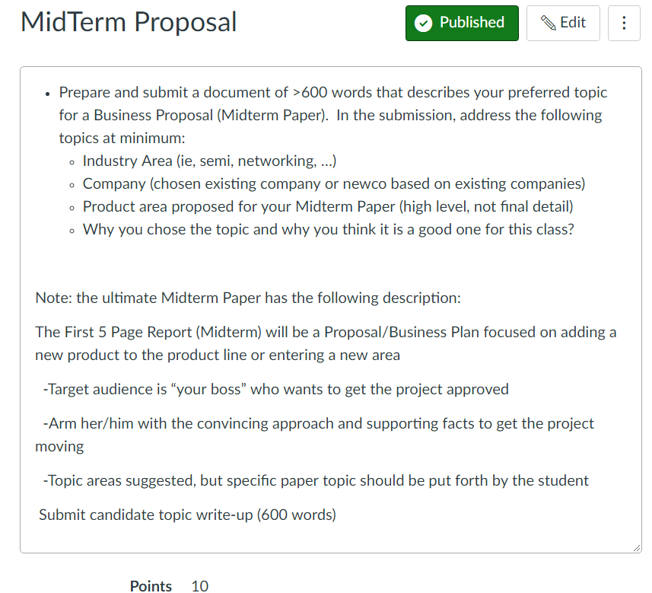

Slide 15
Topic Areas
Networks, AI, wireless, IC technology, drones, driverless cars, robotics, are all moving at high speed
Examples:
-A wireless Chipset company that has large market share in 4G proposes a 5G Project (Nvidia, Intel, Qualcomm, Nvidia)
-An established Networking company proposes adding extensions to its product line
-A GPS company that sells navigation units considers expanding to address autonomous cars
-Network company considers adding big data services by adding analytics to their process
A startup team out of Google wants to build driverless cars

Slide 16
The Opportunity (1)
What is the Product or Service?
Product or Service Description
History of Successful ventures
Need for the Product/Service
Proposed Enhancements
How does your Core Strength relate to the product or service?
Do you outsource for the capabilities outside of your Core Strengths?
Here the author can be specific --How to extend previous core strengths into a future product area?

Slide 17
The Opportunity (2)
Why is this now an Opportunity?
What is the business concept that will address this need or take advantage of the opportunity?
Is the market large and growing? Or is it a small niche market but you expect it to grow?
Real world opportunities are key here. Networks, AI, wireless, IC technology, drones, driverless cars, robotics, are all moving at high speed

Slide 18
The Industry
What’s the nature/degree of competition in the industry?
Who are the main competitors?
How will the company differentiate itself from the competition?
Examples:
-A wireless Chipset company that has large market share in 4G proposes a 5G Project (Nvidia, Intel, Qualcomm, Nvidia)
-An established Networking company proposes adding extensions to its product line
-A GPS company that sells navigation units considers expanding to address autonomous cars
-Network company considers adding big data services by adding analytics to their process
- A startup team out of Google wants to build blimp-based telecom for cities

Slide 19
An Example: Vertical Wireless Location
Industry Area | Wireless communications and navigation area (cellular and GPS)
Company | NextNav LLC, founded by leaders from Qualcomm (cellular technology), Trimble (GPS), TI (semiconductor)
Product Overview | Vertical location capability that can be added to mass market smartphones, providing floor level (<3m vertical error) location in high rise buildings
Why the topic? | Precise vertical location is a valuable capability that cannot be satisfied by existing mobile devices GPS and WiFi location cannot provide sufficient vertical precision to define a single floor level (10-20 m accuracy = 3 to 6 floors) NextNav engineers have identified a technology that can provide the precise vertical positioining, that can be implemented at low incremental cost to all US mass market wireless smartphones (around 150M units per year by 2019) The infrastructure cost of this solution, for covering the top 50 US cities, is modest, expected to be less than $10M

Slide 20
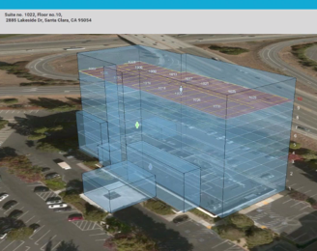
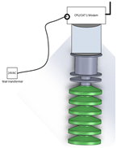
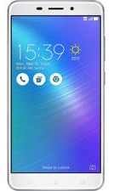
Altitude Service Components
Mass Market & Public Safety Devices
Applications and Services
Infrastructure
NN Altitude Equip.
Non-radiating
Network
Uses LTE or other telemetry links
No spectrum required for commercial service
Content
Maps
Altitude data
Apps and Services
NextNav Cloud
Content
Service-related Databases
(eg, building floors )
NN Z Axis Client Software
Context
Uniquely manages barometric sensor data on a per device basis

Slide 21
For Sep 12: Turn In Online
Prepare and submit a document of >600 words that describes your preferred topic for a Business Proposal (Midterm Paper). In the submission, address the following topics at minimum:
Industry Area (ie, semi, networking, …)
Company (chosen existing company or newco based on existing companies)
Product area proposed for your Midterm Paper (high level, not final detail)
Why you chose the topic and why you think it is a good one for this class?
UNDERLINE OR HIGHLIGHT THE TOPIC SENTENCE OF EACH PARAGRAPH
Note: the ultimate Midterm Paper has the following description:
The First 5 Page Report (Midterm) will be a Proposal/Business Plan focused on adding a new product to the product line or entering a new area
-Target audience is “your boss” who wants to get the project approved
-Arm her/him with the convincing approach and supporting facts to get the project moving
-Topic areas suggested, but specific paper topic should be put forth by the student

Slide 22
For Sep 17: Discuss in Class
Topic for Business Proposal
Industry Area (ie, semi, networking, …)
Product (software, service, IC product line, system..)
What makes product “special”?
What are key technical and market challenges of the product?
Discuss within groups and be prepared to be give a 1 minute overview to class

Slide 23
Tech Descriptive Writing: Blockchain Description

Slide 24
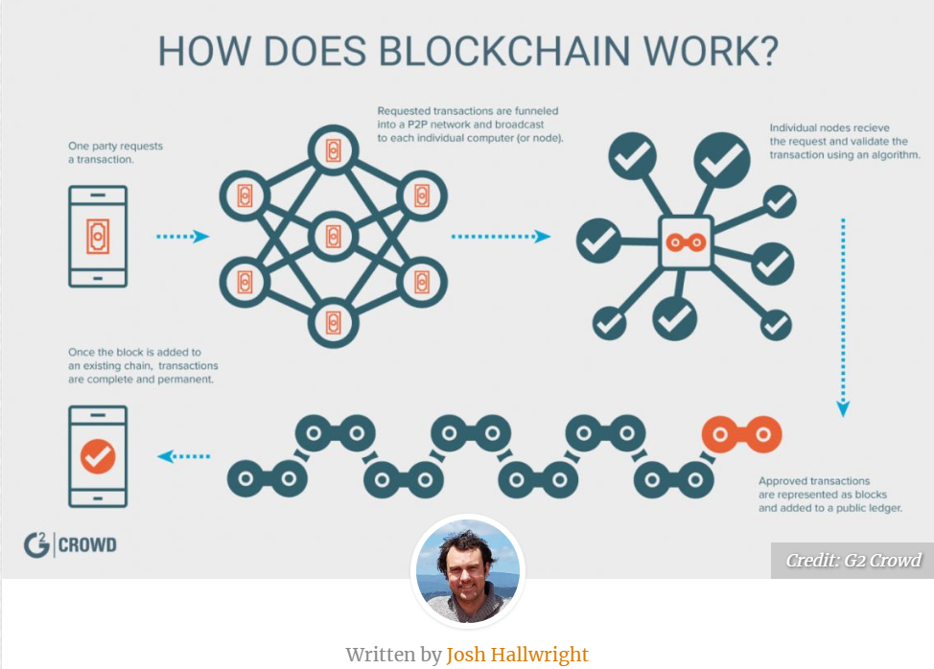

Slide 25
Blockchain Discussion Items
Report Type? Product/Technology Description
Key conclusions of report:
What is Blockchain (BC) and why is it important?
How does BC work?
What can BC do?

Slide 26
Out of Class Writing Assignment #2
Due, Thu, Sep 19 @11:59pm
FOLLOW ALL INSTRUCTIONS
-Write an informational report to describe "What is Blockchain?" and submit via Canvas
1. 500-600 words (approx 2 pages #12 font double spaced). NO PICTURES, JUST TEXT DESCRIPTION. The goal is that the audience (class members) can understand and describe what Blockchain is and what the technology can do based on your description.
2. Provide a title followed by 3 or 4 paragraphs using the following high level outline:
a. Summary
b. Body
c. Conclusion
3. As a condition of grading, supply the following (on a “Self Grading Report” page following the assignment)
a. Word count
b. Underline or highlight the topic sentence of each paragraph in the paper
c. Provide your check of the EE295 key elements by filling out and including certification of 1. No personal pronouns, 2. No use of passive voice, 3. no use of "very", 4. All paragraphs complete and at least 3 sentences. Provide a table with these four rows and a column noting your compliance to each element.

Slide 27
Ch 3: Impact of Technology (Moriarty)
-How does a technology Invade or Colonize the world?
+Productivity
+Efficiency
-Technology has intended and unintended consequences
+Primary impact by design
+Other consequences by impact of “colonization” once tech has “settled” into the world
-Modern engineering is mainly a colonizing process
+The main purpose of the technology is accomplished
+Repercussions to the rest of the lifeworld are largely unchecked

Slide 28
In Class Discussion
-Three Examples of “Colonization” by Technology
+ Intended Consequences
+ Unintended Consequences
+What could have been done to limit colonization by the technical side?

Slide 29
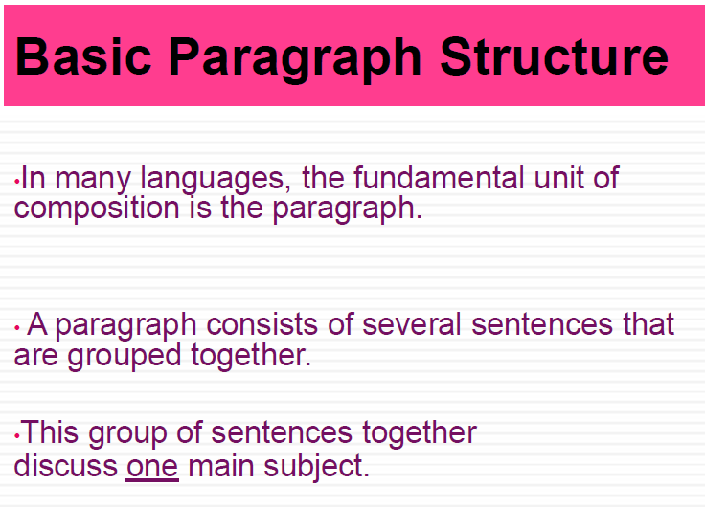

Slide 30
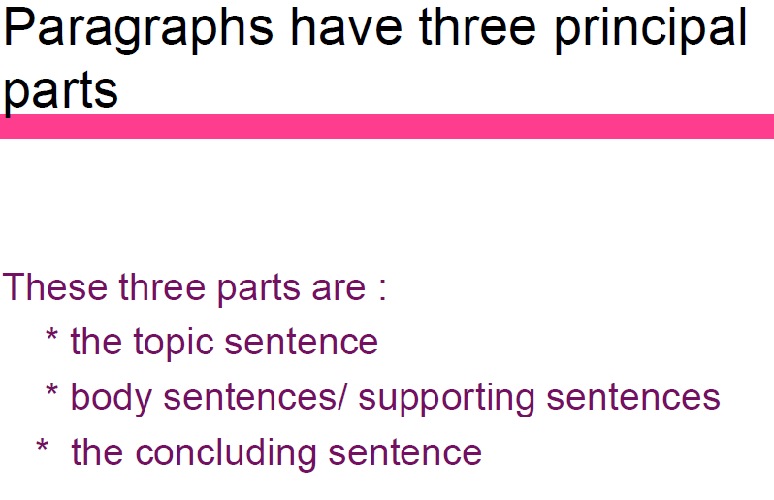

Slide 31
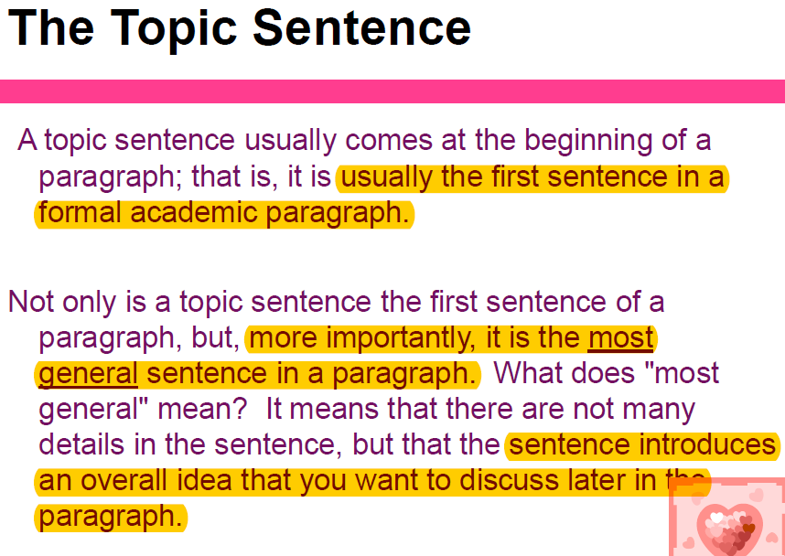

Slide 32
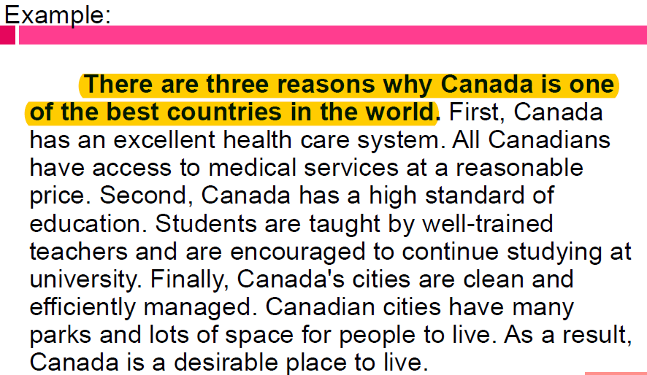

Slide 33
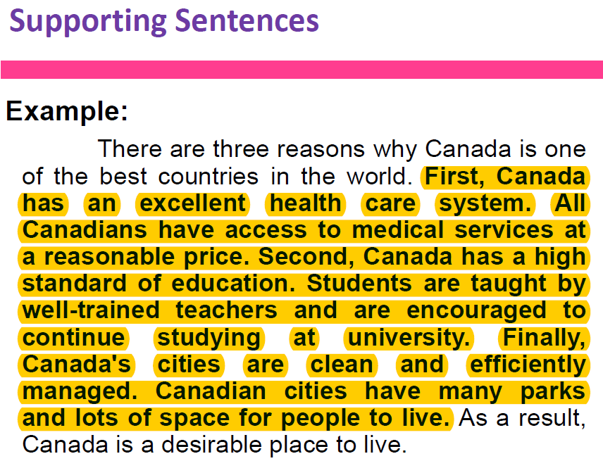

Slide 34
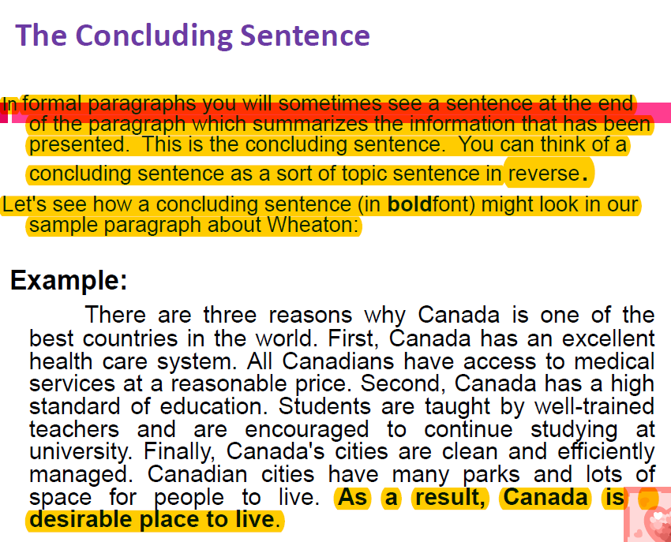

Slide 35
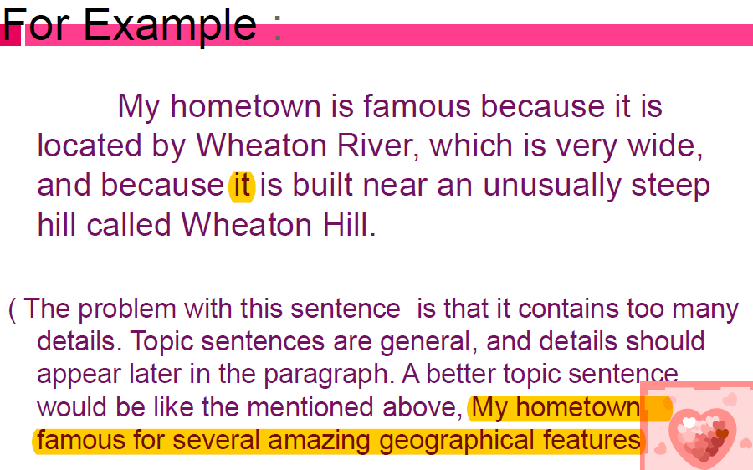

Slide 36
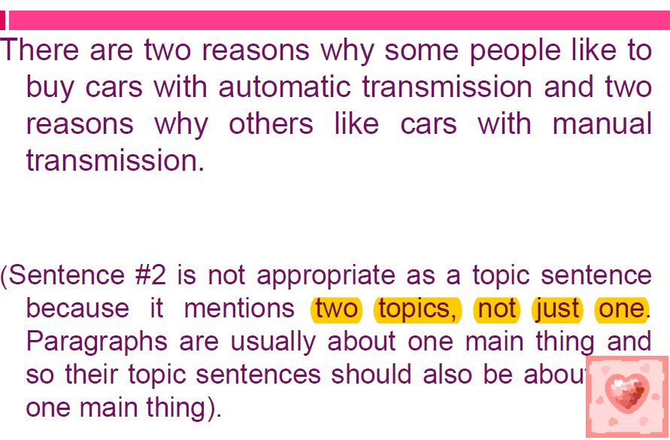

Slide 37
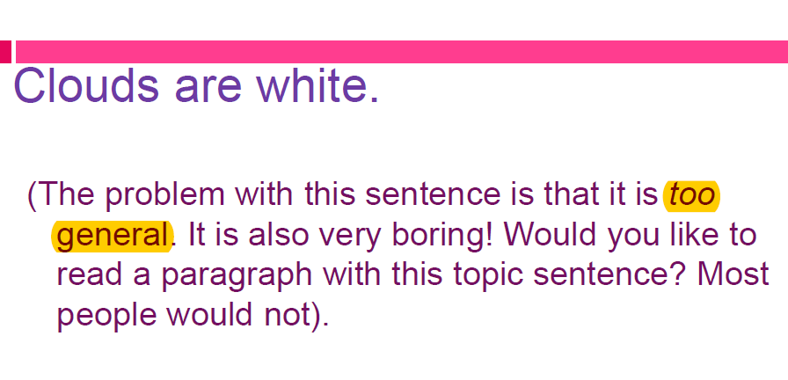

Slide 38
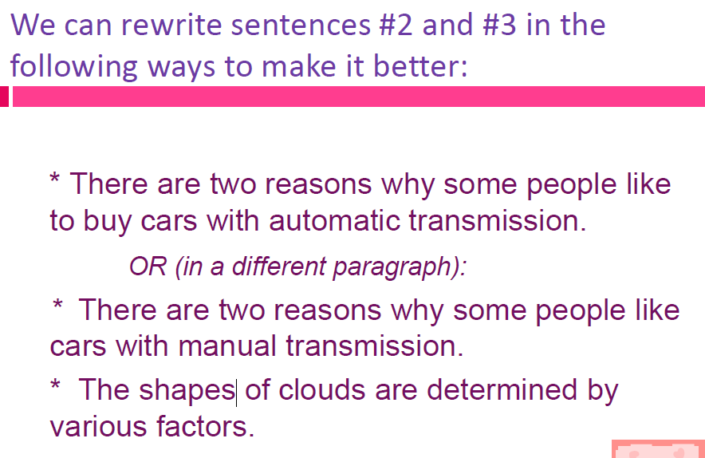

Slide 39
